Slide 1
Arduino LoRa
Simply explained

Slide 2
LoRa
Means ‘Long Range’.
Is a low power system.
Range of 20km with direct line of sight.
3.3V logic level.
Highly compatible with Raspberry Pi and Arduino.
Uses the Serial Peripheral Interface (SPI) to communicate.

Slide 3
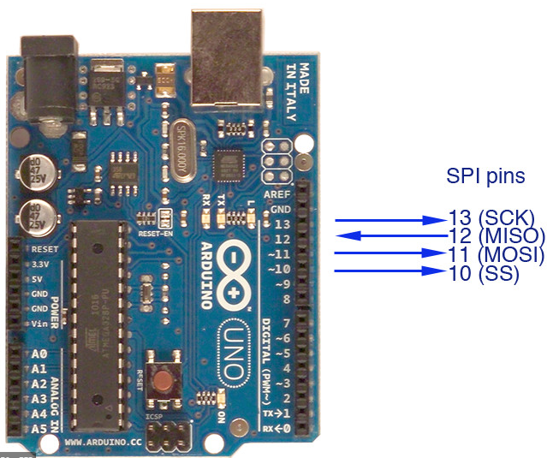
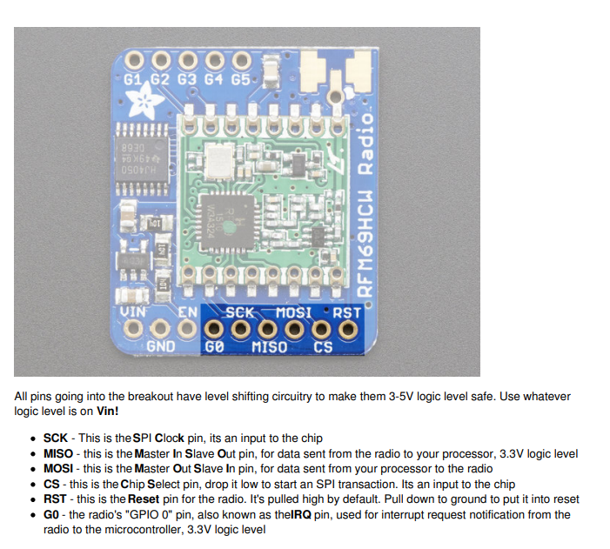
How does LoRa work?
RFM96W works on 433MHz

Slide 4
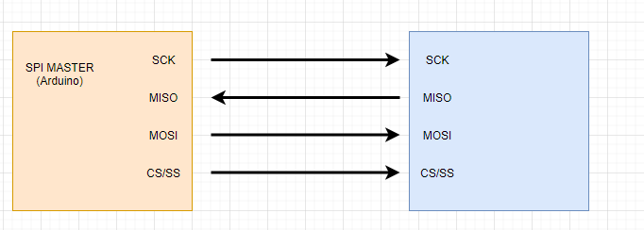
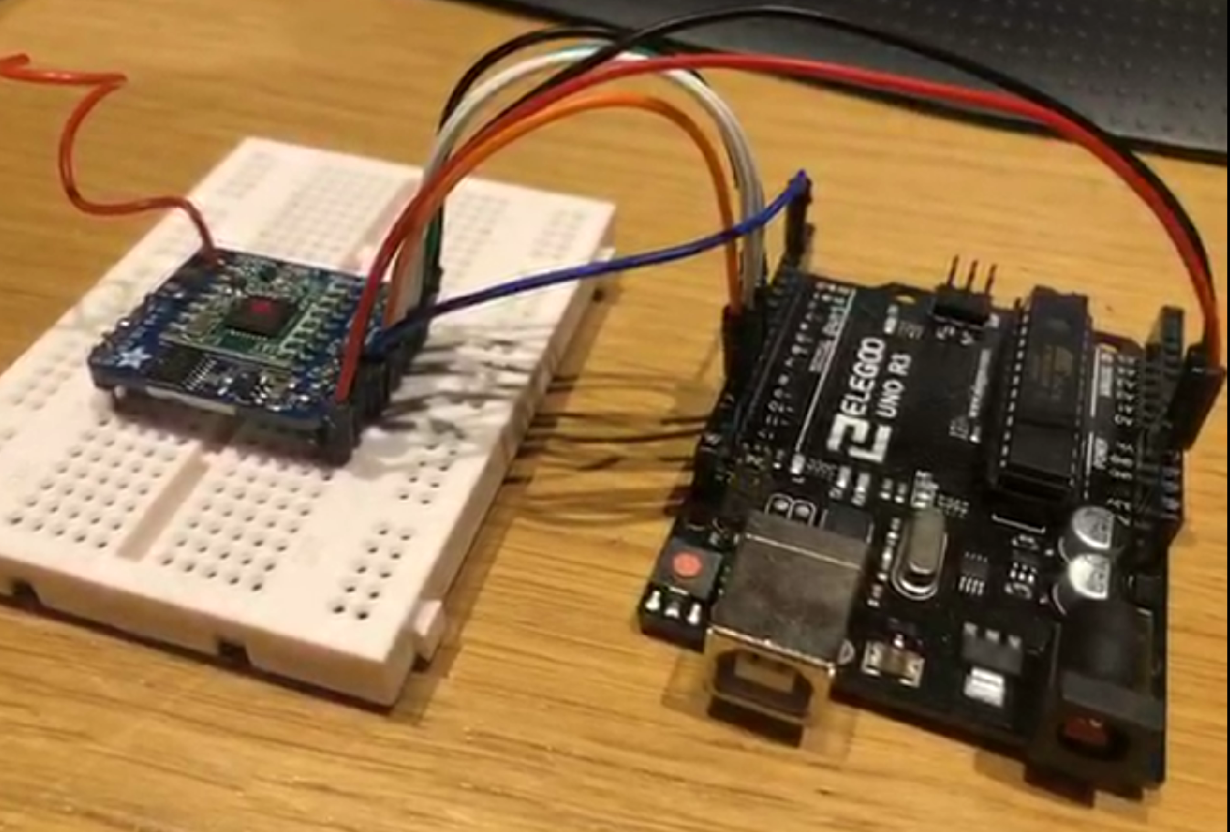
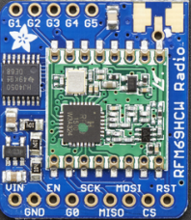
Rundown of SPI and Chip Select
When CS/SS is LOW, the Module will accept signals from SCK, MISO and MOSI.
MOSI = Master Out Slave In
MISO = Master In Slave Out
SCK = Serial Clock
CS/SS = Chip Select/Slave Select

Slide 5
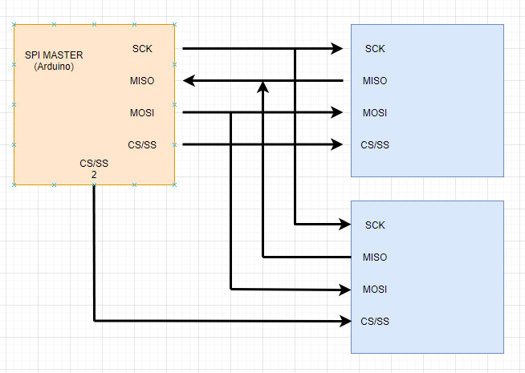
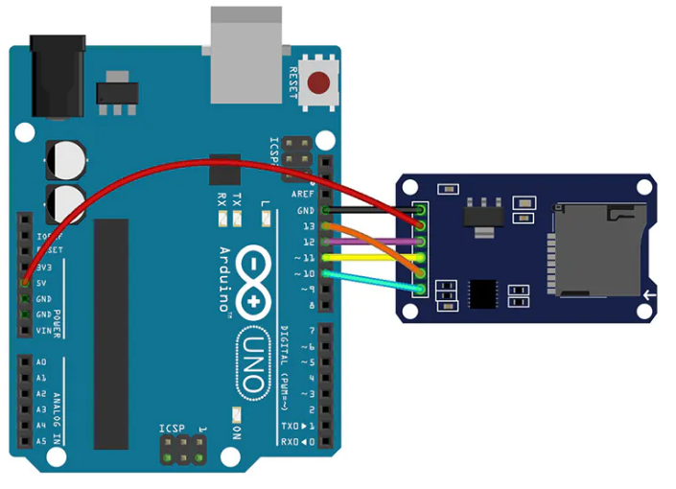
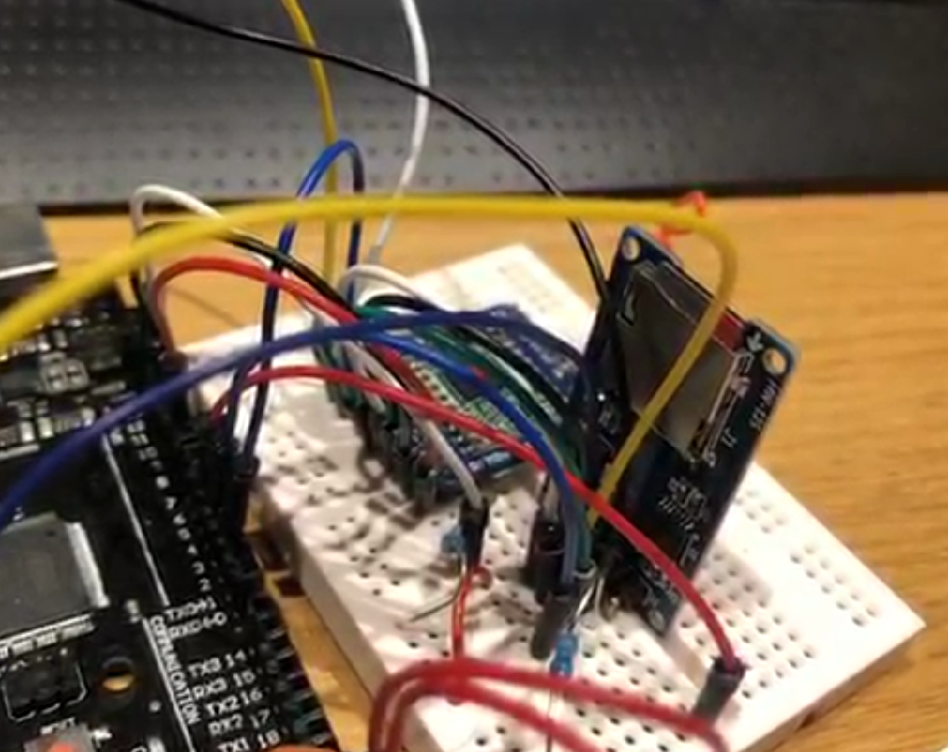
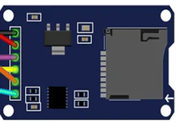
Multiple SPI modules

Slide 6
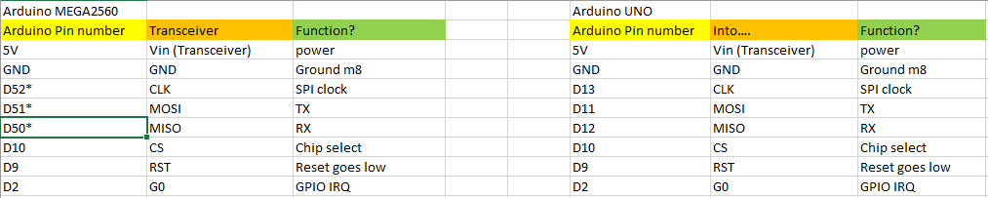
Pin Table

Slide 7

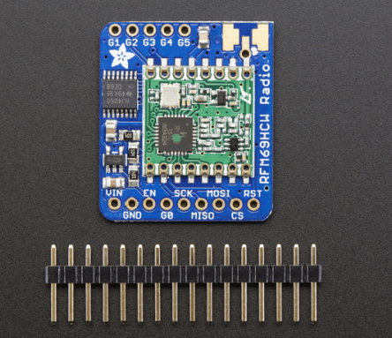
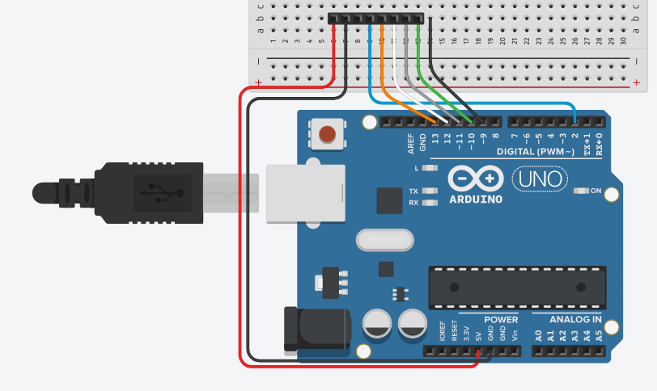
Getting Setup.

Slide 8
Code
Uses the SPI.h and LoRa.h Libraries linked in GitHub
Example Code is linked in GitHub
https://github.com/HeppleHepp/T2W-Speed-controller-
https://www.okdo.com/p/adafruit-rfm96w-lora-radio-transceiver-breakout-433-mhz-3073/ - Adafruit RFM 96W 433MHz
Datasheet for the transceiver is on the GitHub page

